Slide 1

DIRECTORATE OF ONLINE EDUCATION
SRM INSTITUTE OF SCIENCE AND TECHNOLOGY
KATTANKULATHUR- 603 203
BCA III SEM
PROJECT
December 2024
ENROLMENT NUMBER : EA2331201010292
NAME OF STUDENT: SHANMUGA SUNDARAM M

Slide 2
Student Management System
PROJECT GUIDE : Dr. Muthuselvam M

Slide 3
CONTENTS
Abstract
Introduction
Project Scope
Product Functions
Features
Module Description
System Requirements
Data Flow Diagram
Entity Relationship Diagram
Use Case Diagram
Class Diagram
Sequence Diagram
UML Diagram
Output Screenshots
Source Code
Conclusion
Feature Enhancements
Reference

Slide 4
ABSTRACT
The Student Management System is a comprehensive web application developed to simplify and automate the management of student records in educational institutions.
It enables efficient handling of student data, including personal information, grades, and attendance, through an intuitive user interface.
The system supports core functionalities such as adding, updating, deleting, and searching for student records, ensuring real-time updates across all connected users.
By integrating a secure backend with an Oracle database and utilizing modern design principles, the system offers scalability, reliability, and ease of use, streamlining administrative processes and reducing manual errors.

Slide 5
INTRODUCTION
The Student Management System is a software application designed to help educational institutions manage student data efficiently.
It streamlines processes such as adding, updating, and searching student records. The system integrates a user-friendly interface with a real-time database, ensuring quick access and modification of data.
Through the use of modern software design principles and patterns, the system offers scalability, maintainability, and ease of use for both administrators and users.
The project aims to automate routine tasks, reducing manual effort, and improving the accuracy and speed of student data management..

Slide 6
Product Functions
1. Add Student
2. Update Student
3. Delete Student
4. Search Student
5. List Students

Slide 7


FEATURES
User-friendly UI
A user-friendly UI ensures that a user can accomplish their tasks easily, quickly, and effectively with little frustration or confusion. It's about creating an experience where users feel comfortable and empowered to use the system without needing technical expertise.
Search functionality
Search functionality allows users to quickly find specific information or content within an application or website by entering keywords or phrases. It typically uses a search bar or input field where users can type their query, and results are displayed based on relevance. Effective search functionality may include filters, suggestions, or auto-completion to enhance the user experience. It helps save time and improves navigation by efficiently locating data across large volumes of content.
Real-time database updates
Real-time database updates enable instant synchronization of data across all users and devices without the need for manual refresh. Changes made in the database are immediately reflected on all connected clients, ensuring that all users see the latest information in real time.

Slide 8
MODULE DESCRIPTION
User Authentication and Authorization::
This module allows users to securely log in to the system using their credentials.
It manages access control to ensure that only authorized users (admin, staff, students) can access the appropriate features.
Student Registration and Profile Management:
Students can be registered into the system by entering essential personal and academic details.
This module also allows for updating and managing student profiles.
Course Management:
Admin’s can add, update, and remove courses offered within the institution.
It also allows for managing course schedules, durations, and associated faculty.

Slide 9
MODULE DESCRIPTION
Attendance Management:
This module allows instructors to mark student attendance for each class.
The system stores attendance records and can generate reports based on student attendance.
Grading and Evaluation:
Teachers can enter grades for assignments, exams, and other assessments.
The system calculates final grades and provides a comprehensive report card for students.
Search Functionality:
The search module allows users to quickly locate students, courses, or grades.
It supports filtering and sorting to improve the search experience.

Slide 10
MODULE DESCRIPTION
Real-time Database Updates:
Any changes made to student data, grades, or attendance are instantly reflected across the system.
This ensures that all users are working with the most up-to-date information.
Notifications and Alerts:
The system sends notifications to students and faculty for important events like upcoming exams, course registration deadlines, or grade updates.
Reports and Analytics:
Admins and faculty can generate various reports such as student performance, attendance trends, and overall course statistics to aid decision-making.

Slide 11
MODULE DESCRIPTION
Backup and Data Recovery:
This module ensures regular backups of all system data to prevent data loss.
In case of failure, it provides recovery options to restore data to a specific point in time.

Slide 12
SYSTEM REQUIREMENTS
Hardware Requirements
Software Requirements
Processor | Intel Core i3 or more
RAM | 2 GB Or more
Hard Disk | 2 GB or more
Monitor | 15” colour monitor or better
Keyboard | Any Keyboard
Mouse | Any mouse
Printer | In case of printing of reports
Network | Connected to internet directly or via proxy server. Internet bandwidth of at least 10 Mbps. Able to connection to Google email services.
Operating System | Windows 8 or higher
Language | Java version 1.8 or more
Database | Oracle DB 21 0r more
Browser | Google chrome (other browsers not supported readily)
Framework | Visual Studio Code Node JS Google Chrome Web driver (for browser automation) HTML CSS Oracle DB
Application Development | IntelliJ IDEA (for development)

Slide 13
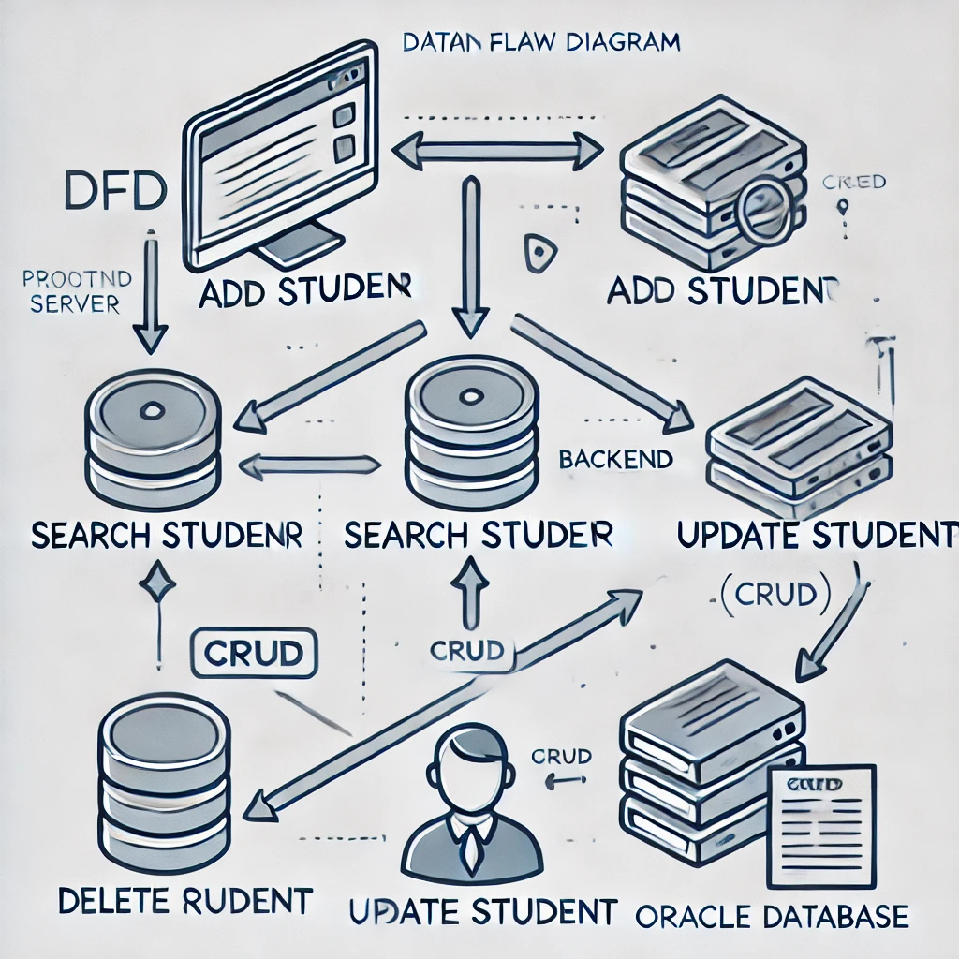
Data Flow Diagram (DFD)
Visual representation of the data flow in the system

Slide 14
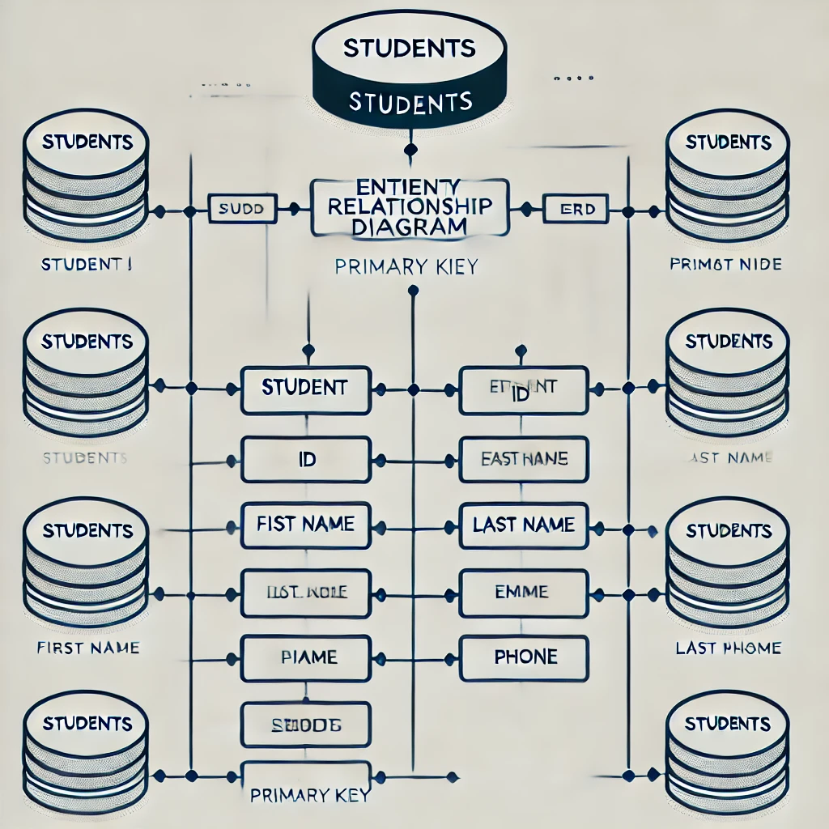
Entity Relationship Diagram (ERD)
Visual representation of the ERD flow in the system

Slide 15
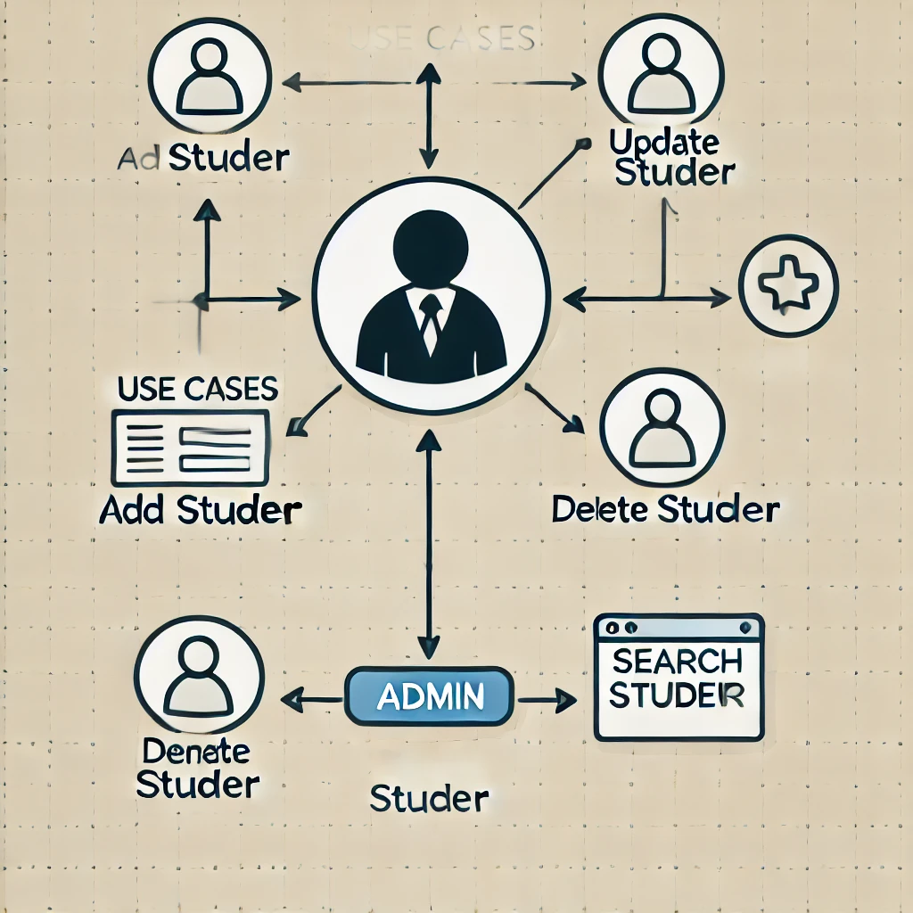
Use Case Diagram
Visual representation of the USD flow in the system

Slide 16
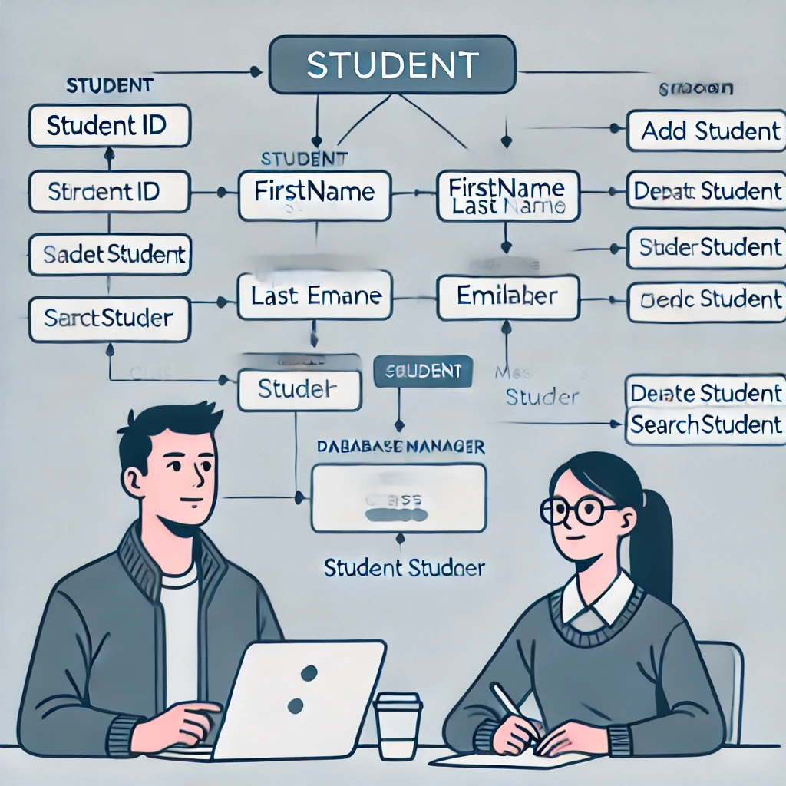
Class Diagram
Visual representation of the Class Diagram flow in the system

Slide 17
SOURCE CODE – GITHUB LOCATION
The Complete Source code is found in the following GitHub location: https://github.com/Ssundaram743/mini-project.git

Slide 18
CONCLUSION
the Student Management System is an essential tool designed to improve the efficiency and effectiveness of managing academic data in educational institutions. It offers a user-friendly interface and a set of powerful features that cater to the needs of students, faculty, and administrators. The system integrates various modules that work seamlessly together to manage student profiles, courses, attendance, grades, and more, ensuring a smooth and organized flow of information.
Extensible and Template Driven Design:
The Student Management System is built with an extensible and template-driven design, allowing for easy customization and scalability.
New modules and features can be added without disrupting the core functionality, ensuring long-term adaptability.
This design approach also enables the system to integrate seamlessly with other tools and platforms used by the institution.
OOAD Approach:
The Object-Oriented Analysis and Design (OOAD) approach was used to develop the Student Management System, focusing on identifying key objects and their interactions.
Design Patterns:
Design patterns were applied in the development of the Student Management System to address common software design challenges. Patterns like MVC (Model-View-Controller) were used to separate concerns, ensuring a clean and maintainable codebase.
This approach enhances code reusability and scalability while making the system easier to test and modify.

Slide 19
FUTURE ENHANCEMENTS
1) Improve Scalability
• Incorporate muti-threaded processing to perform parallel extraction and notifications of jobs.
• Use mix of technologies like Python/BeautifulSoup to perform extractions. This will help to overcome the limitations of multi-instance Chrome or Edge drivers.
2) Ability to run extraction process fine grained
• Users or the Batch job should be able to run the extraction process in multiple groups. Eg. Ability to run at the country level or certain groups.
• The job groups can run at different scheduled times.
3) Apply ML / NLP
• Classify content for compliance, financial data, service regulations, etc.
• Indentify severity.
Identify datelines of implementation.
• Affected organizations and divisions.

Slide 20
REFERENCES
Technology references
https://www.W3School.com/
https://developers.google.com/gmail/api/guides
https://www.oracle.com/java/
https://spring.io/projects/spring-framework/
https://spring.io/projects/spring-data-jpa
https://projectlombok.org/
https://www.sql.com/
https://www.geeksforgeeks.org/software-design-patterns/
https://www.geeksforgeeks.org/object-oriented-analysis-and-design/

Slide 21

THANK YOU

